Slide 1

CoPilot Safe Assist
Software Engineering 2: Project Teamwork Mälardalen University
Optimus Octavian

Slide 2

The problem

Slide 3




Client
Problem
Construction Equipment
Accidents at construction sites

Slide 4

The members

Slide 5
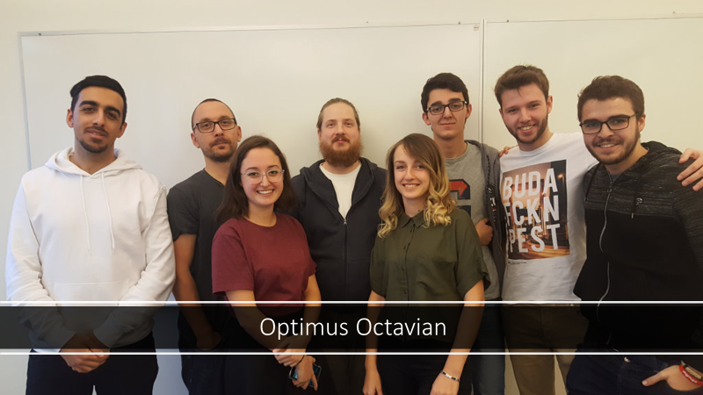

Slide 6





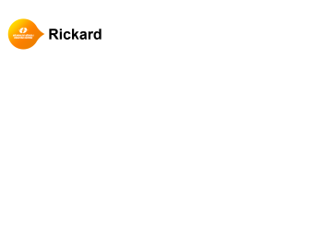
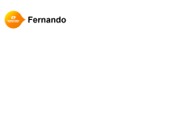


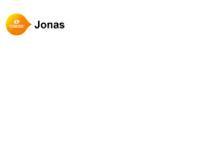
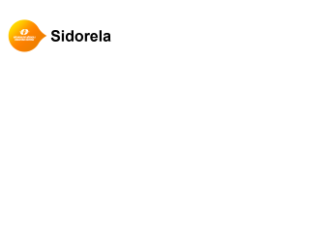











Slide 7
Dara

Slide 8
Rickard

Slide 9
Vasja

Slide 10
Jonas

Slide 11
Sidorela

Slide 12
Fernando

Slide 13
Pablo

Slide 14
Alvaro

Slide 15
Tasks!
Álvaro - Notetaker
Dara - Presentation Overseer
Fernando - Conﬁguration Manager (Android Studio)
Jonas - Presentation Overseer
Pablo - Conﬁguration Manager (Trello)
Rickard - Conﬁguration Manager (GIT)
Sidorela - Client Contact, Documentation
Vasja - Group Manager

Slide 16

Communication

Slide 17







Slide 18

Wednesday
Working group meeting
Friday
Big group meeting
Monday
Steering group meeting
Weekend

Slide 19
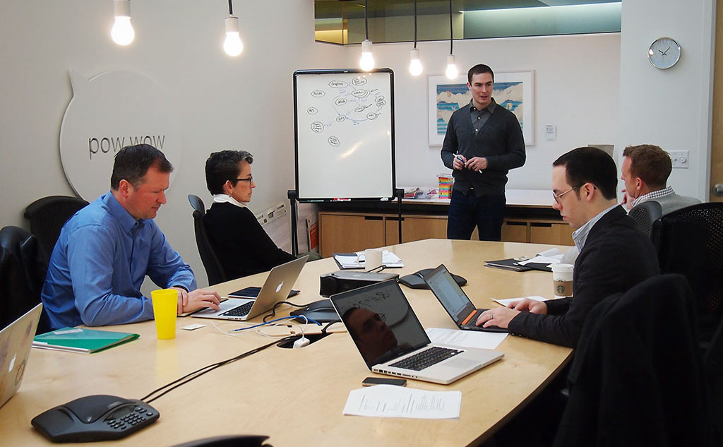
Client meeting

Slide 20


Client meeting
Much cars
Such Volvo
WoW

Slide 21

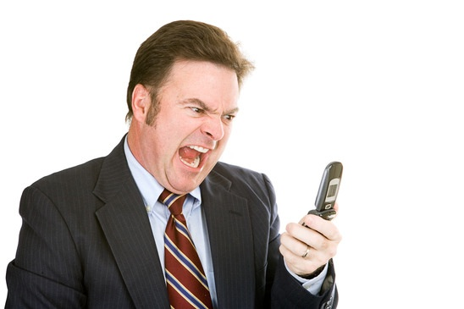
Client meeting

Slide 22
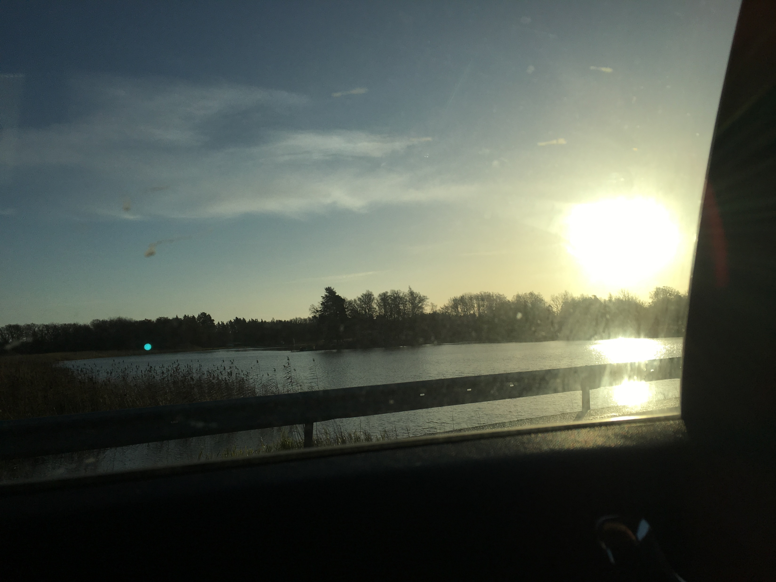
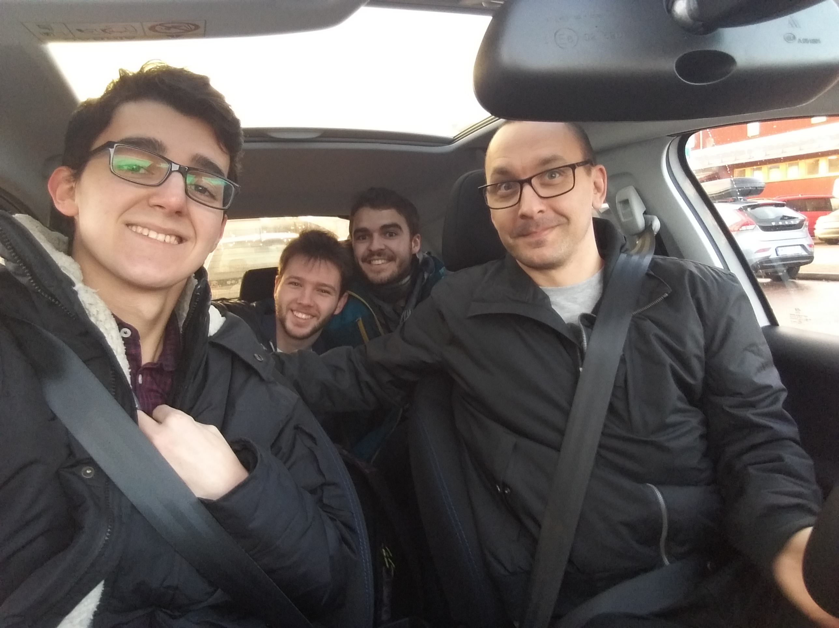
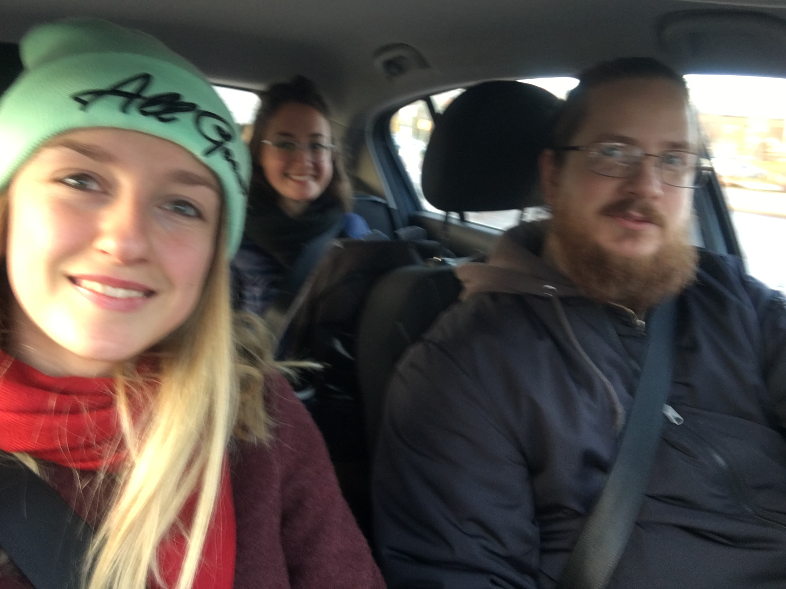
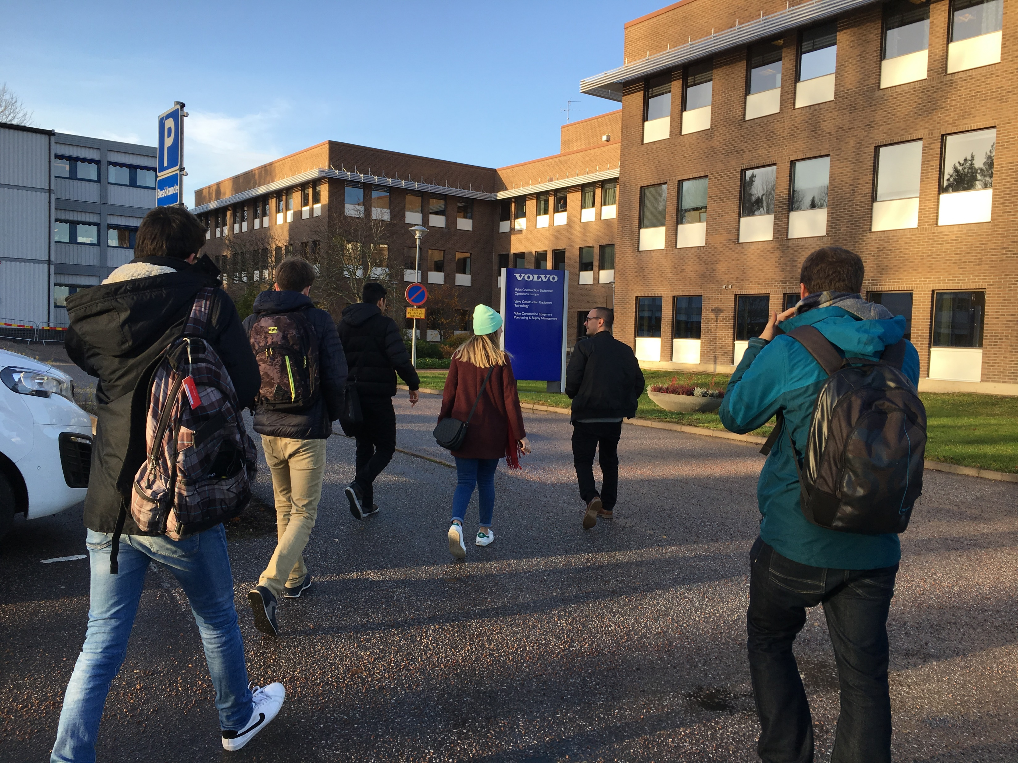
Client meeting

Slide 23
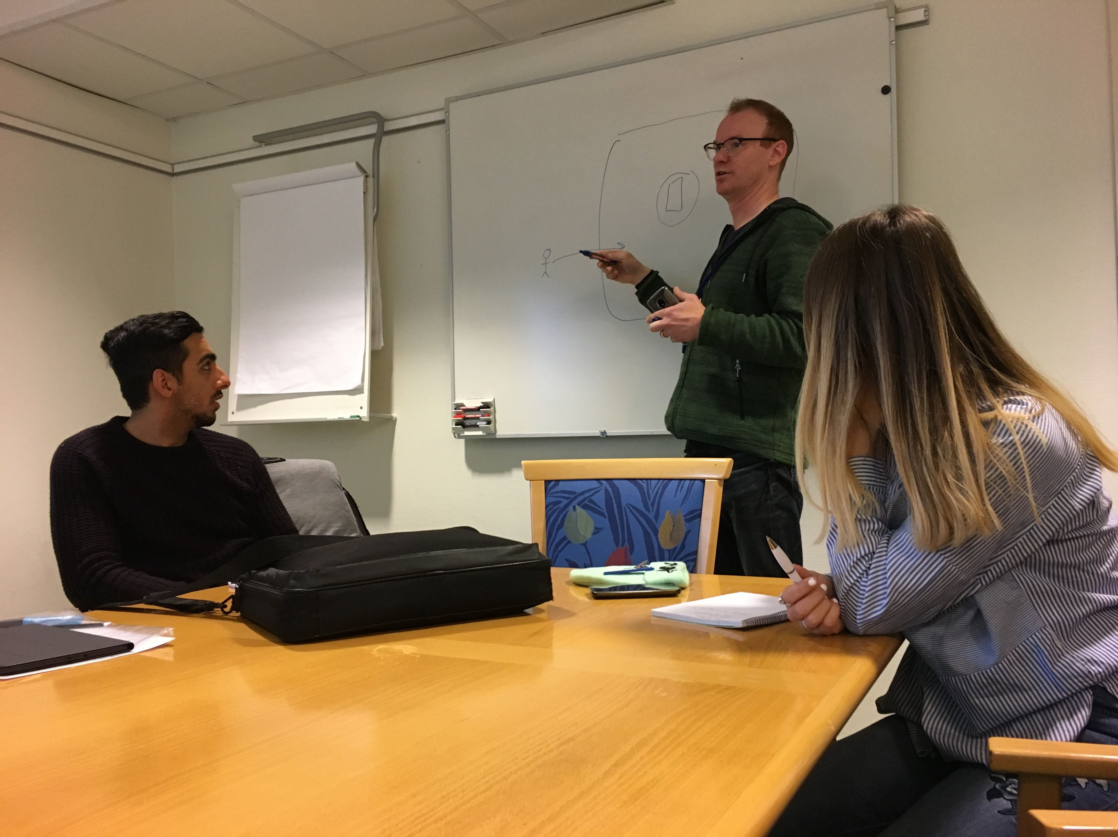
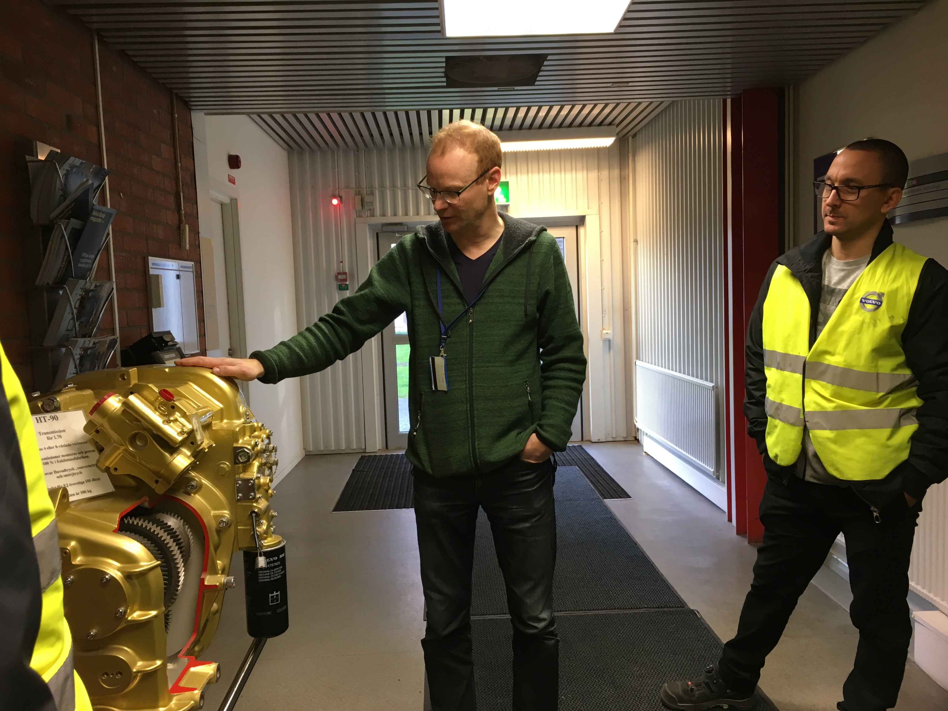
Client meeting

Slide 24
Client meeting
Many questions…
Very strict requirements vs Find a way to get a goal
Many devices vs Specific device
Plan-driven vs Agile
No interaction vs Lots of interaction
GPS vs Bluetooth
…

Slide 25

System description

Slide 26
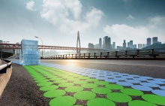
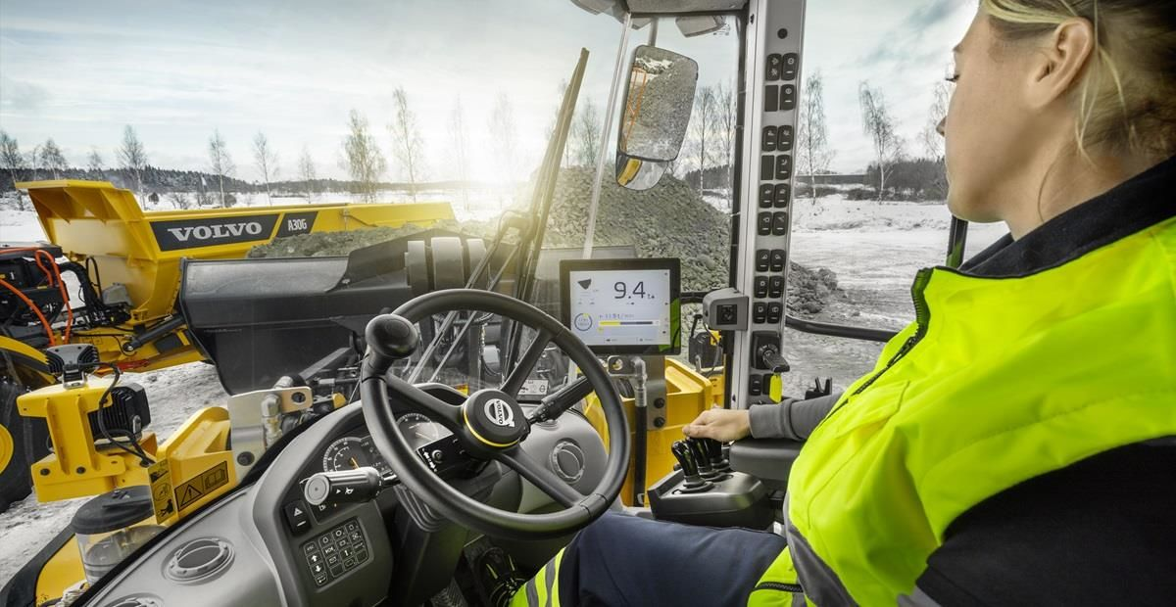
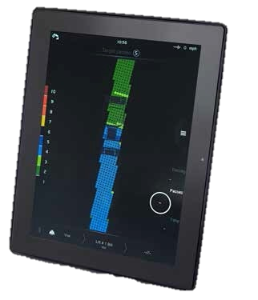
System description

Slide 27
Client meeting
Many questions…
Very strict requirements vs Find a way to get a goal
Many devices vs Specific device
Plan-driven vs Agile
No interaction vs Lots of interaction
GPS vs Bluetooth
…

Slide 28

Client meeting
Many questions…
Very strict requirements vs Find a way to get a goal
Many devices vs Specific device
Plan-driven vs Agile
No interaction vs Lots of interaction
GPS vs Bluetooth
…

Slide 29
System description
Safe Assist
It’s a way to avoid construction accidents while using heavy machines

Slide 30
System description
Safe Assist
It’s a way to avoid construction accidents while using heavy machines
There is a defined area with coordinates which is considered the construction area

Slide 31
System description
Safe Assist
It’s a way to avoid construction accidents while using heavy machines
There is a defined area with coordinates which is considered the construction area
Has information about the position of both operators & machines within the area

Slide 32
Client meeting
Many questions…
Very strict requirements vs Find a way to get a goal
Many devices vs Specific device
Plan-driven vs Agile
No interaction vs Lots of interaction
GPS vs Bluetooth
…

Slide 33
Client meeting
Many questions…
Very strict requirements vs Find a way to get a goal
Many devices vs Specific device
Plan-driven vs Agile
No interaction vs Lots of interaction
GPS vs Bluetooth
…

Slide 34
System description
Safe Assist
It’s a way to avoid construction accidents while using heavy machines
There is a defined area with coordinates which is considered the construction area
Has information about the position of both operators & machines within the area
Issues an alarm & notifies when a machine and a non-driver operator are to close
Notes:
blsablbaslblasnlbsjehfkjr

Slide 35
Client meeting
Many questions…
Very strict requirements vs Find a way to get a goal
Many devices vs Specific device
Plan-driven vs Agile
No interaction vs Lots of interaction
GPS vs Bluetooth
…

Slide 36
Client meeting
Many questions…
Very strict requirements vs Find a way to get a goal
Many devices vs Specific device
Plan-driven vs Agile
No interaction vs Lots of interaction
GPS vs Bluetooth
…

Slide 37
Client meeting
Many questions…
Very strict requirements vs Find a way to get a goal
Many devices vs Specific device
Plan-driven vs Agile
No interaction vs Lots of interaction
GPS vs Bluetooth
…
Updates with progress from time to time and feedback from him

Slide 38
Client meeting
Many questions…
Very strict requirements vs Find a way to get a goal
Many devices vs Specific device
Plan-driven vs Agile
No interaction vs Lots of interaction
GPS vs Bluetooth
…
RESEARCH ABOUT THE BEST WAY TO DO IT

Slide 39






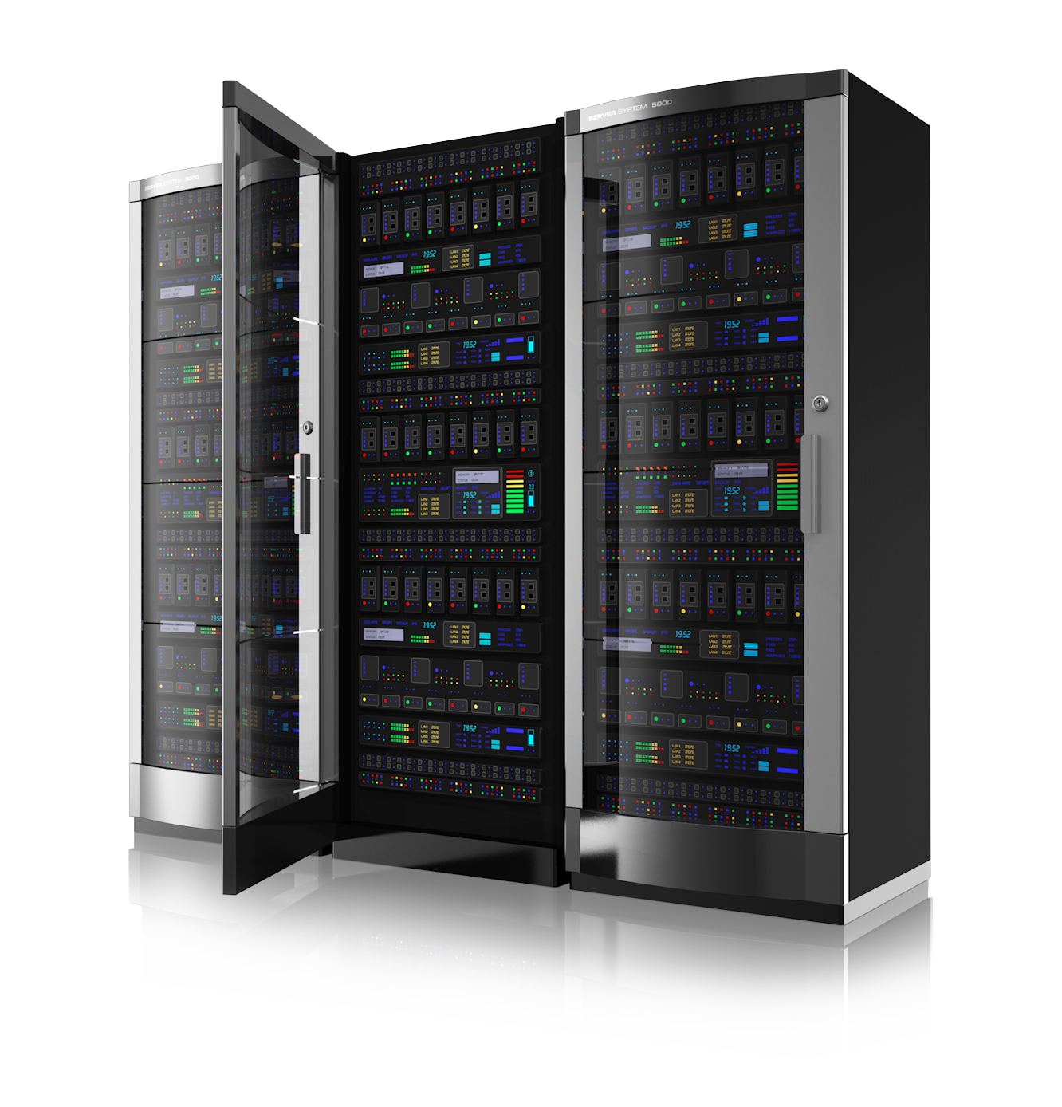
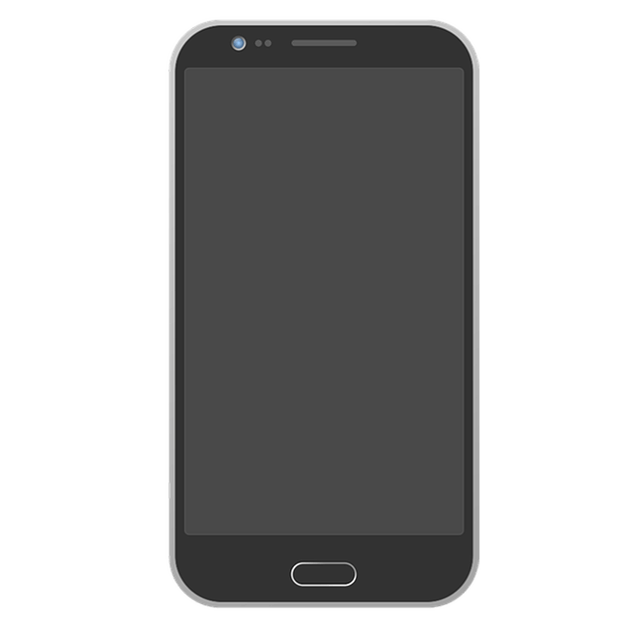
Research time!

Slide 40
Resources
What will we use?
Server database
Server communication
Android app (notifications, background execution)
GPS

Slide 41
Client meeting
Many questions…
Very strict requirements vs Find a way to get a goal
Many devices vs Specific device
Plan-driven vs Agile
No interaction vs Lots of interaction
GPS vs Bluetooth
…

Slide 42
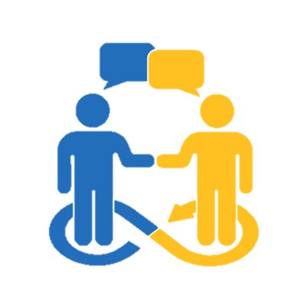
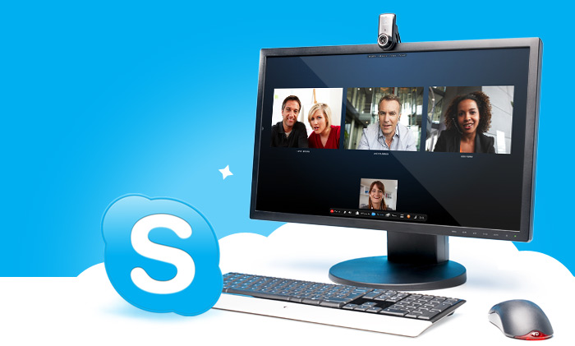

Client meeting

Slide 43
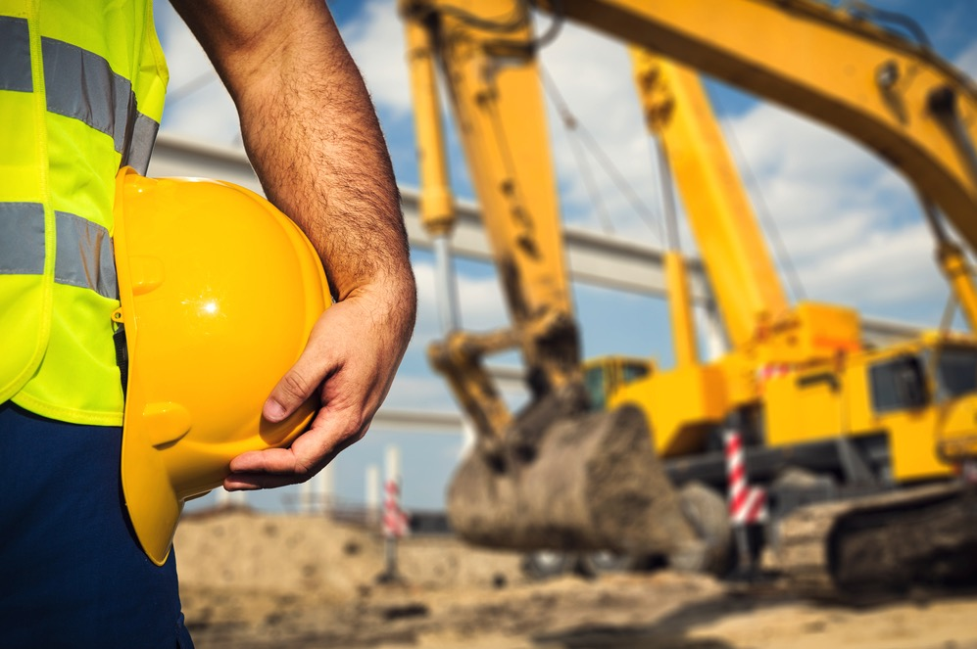
Initial Backlog
Register worker
Warn the workers
Register vehicles
Associate worker with machines
Identify unit
Send location
Set construction sites

Slide 44
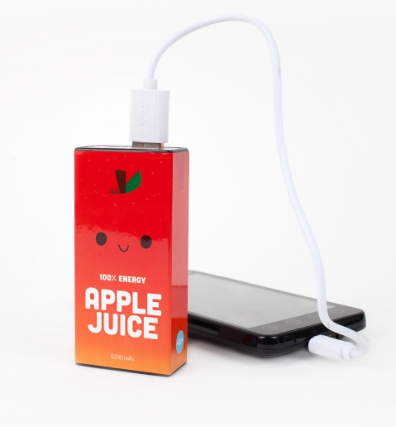
Non-functional Requirement
Quick to update location
Save as much juice as possible
Large views for each element of the CoPilot app
High visual contrast

Slide 45
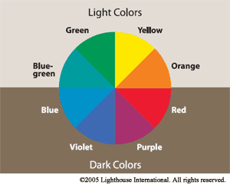
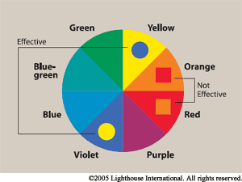
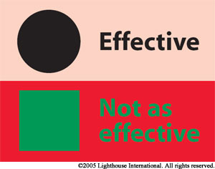

Slide 46
Thank you!

Slide 47
